Slide 1
Learning objective: To be able to define HDI and marginalisation To be able to explain their value in measuring disparities
Key term:
Indices
Disparities
Human development index
Marginalisation

Slide 2
What different ways can countries be classified for development?

Slide 3
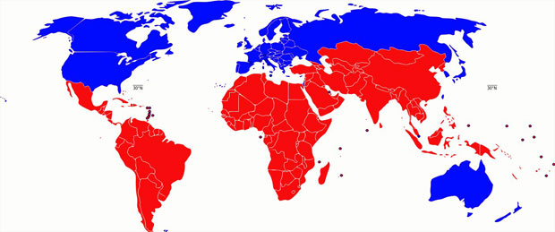
Brandt Line

Slide 4
Positives | Negatives
Simplifies data so that it's easy to understand. GDP is used which is an easy to access data source. | Doesn't include some countries which are more economically developed. Generalised patterns with some countries above the Brandt line less developed less than some below.

Slide 5
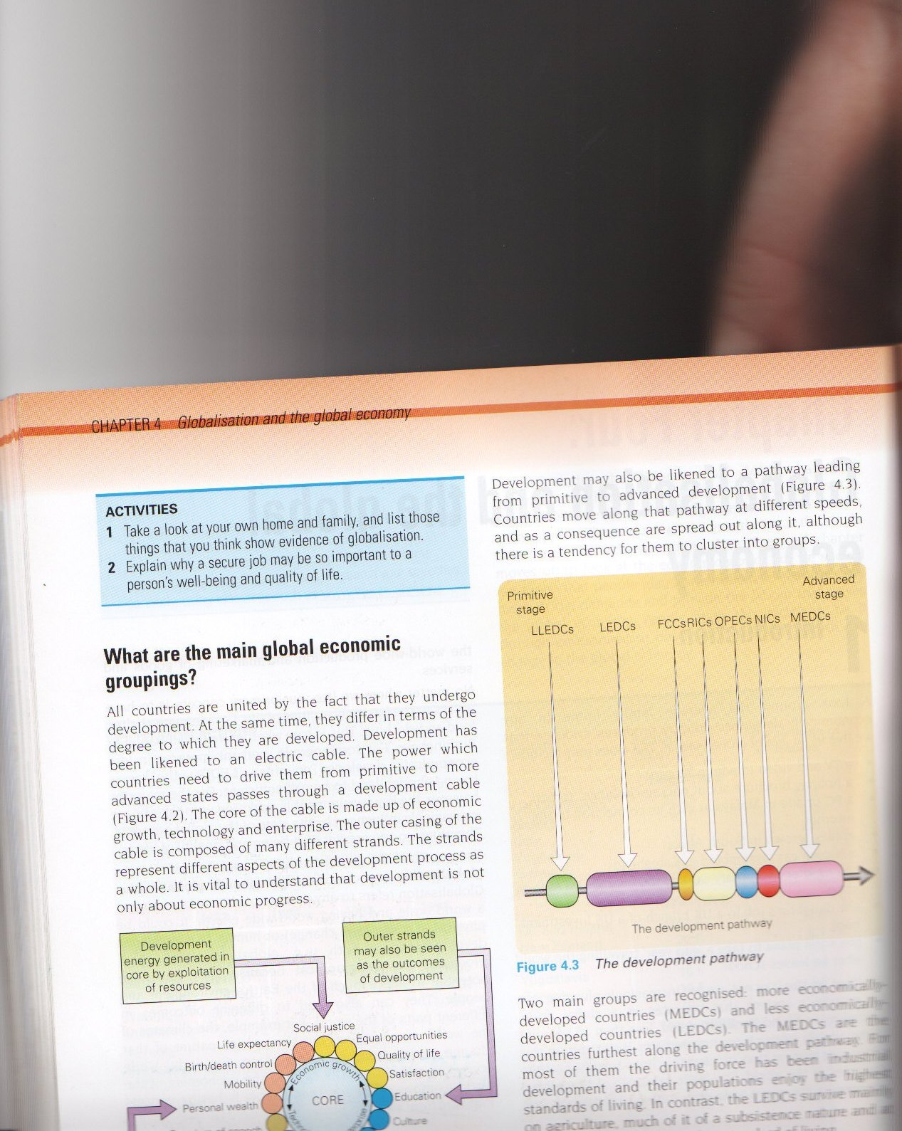
Views on Development
The Development Pathway
Development can also be seen as a pathway.
Countries develop at different speeds and may cluster at different places
What could hinder development?

Slide 6

Make your own human development tree
http://www.zolabo.com/projects/hdi/

Slide 7
Go to the HDI Map
Use the wikispace – how does this compare to the brandt line map?
What are the strengths and weaknesses of HDI as a measurement of disparities?

Slide 8
The human development index
http://hdr.undp.org/en/content/human-development-index-hdi
What is it?
How is it calculated?
What are its strengths? What are its limitations?

Slide 9
What are the strengths and weaknesses of HDI to measure development?

Slide 10
What’s so good about being developed?
http://www.ted.com/talks/nic_marks_the_happy_planet_index?language=en

Slide 11
What are the limitations to the current ways of measuring progress?
What do people consider to be important in life?
How can this be measured?
What is the relationship between ecological footprint and happy life years?
How have Costa Rica achieved success in this new measurement of progress?
How should countries be aiming to achieve improve HPI?

Slide 12
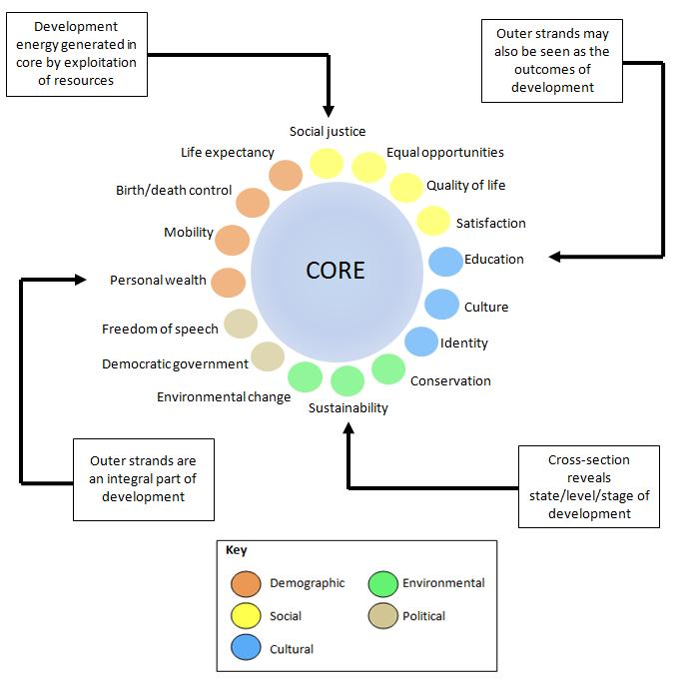

Slide 13
Marginalisation
The process of being pushed to the edge of economic activity
Being left out of positive economic trends
Within a country – the poorest, unemployed and most vulnerable

Slide 14
Index of Marginalisation p89
What is it?
What does it include?
Describe the patterns of marginalization in Mexico

Slide 15
Other indices of development from the course companion
Which do you think is the most useful

